Slide 1

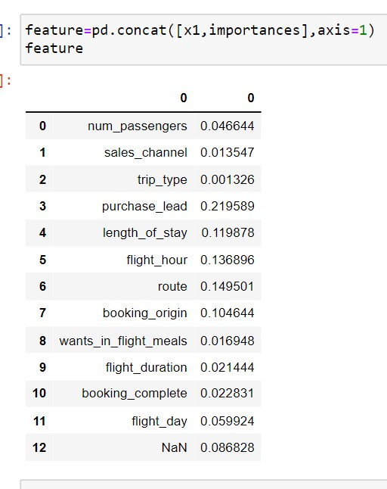
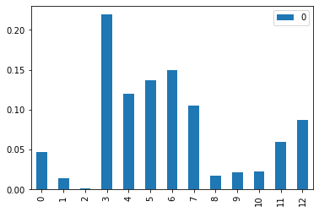
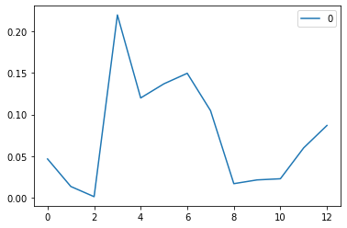
British airways
On the analysis of all dependent and independent variables, got the ‘importance factor’ followed by random forest model selections, after splitting the training and testing data , and applying importance factor, plotted graph for the features, that shows the most influencing factors as:
Purchased lead
Route
Flight hour

